Slide 1


<Joaky Bandzo>
<21 April 2023>

Slide 2

Outline
Executive Summary
Introduction
Methodology
Results
Conclusion
Appendix

Slide 3
Executive Summary
SpaceX advertises Falcon 9 rocket launches on its website with a cost of 62 million dollars; other providers cost upward of 165 million dollars each, much of the savings is because SpaceX can reuse the first stage. Therefore if we can determine if the first stage will land, we can determine the cost of a launch. This information can be used if an alternate company wants to bid against SpaceX for a rocket launch.
To ensure accuracy in the findings, proper methodologies were followed. Data was collected and ensured that it is in the correct format from an API. Data was further cleaned (wrangled) and modelled using data analytical techniques and tools.

Slide 4
Introduction
The private sector is eager to put people in space to pursue their own personal interests, not the state’s and then supply the demand they create. This is the vision driving SpaceX, which in its first twenty years has entirely upended the rocket launch industry, securing 60% of the global commercial launch market and building ever-larger spacecraft designed to ferry passengers not just to the International Space Station (ISS), but also to its own promised settlement on Mars.

Slide 5

Section 1

Slide 6
Methodology
Executive Summary
Data collection methodology:
Data was collected by using API to request data from SpaceX web.
Perform data wrangling
Data was cleaned and processed by application of SQA queries
Perform exploratory data analysis (EDA) using visualization and SQL
Perform interactive visual analytics using Folium and Plotly Dash
Perform predictive analysis using classification models
How to build, tune, evaluate classification models

Slide 7
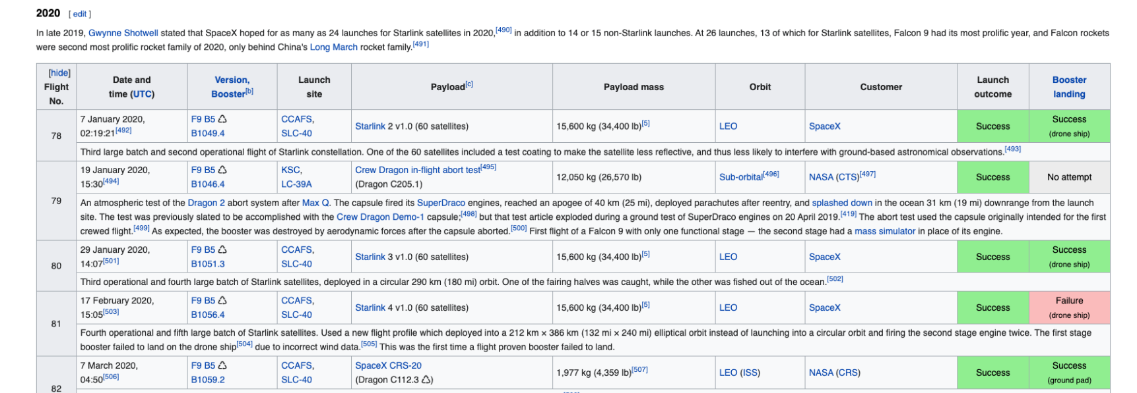
Data Collection – SpaceX API
Web scraping method was used to collect Falcon 9 historical launch records from a Wikipedia page titled List of Falcon 9 and Falcon 9 Heavy Launches. Describe how data sets were collected.
Web Scrap Falcon 9 launch with BeautifulSoup:
Extract a Falcon 9 launch record HTML table from Wikipedia
Parse the table and converted it into a Pandas data frame.
GitHub URL of the completed SpaceX API calls notebook (must include completed code cell and outcome cell)

Slide 8
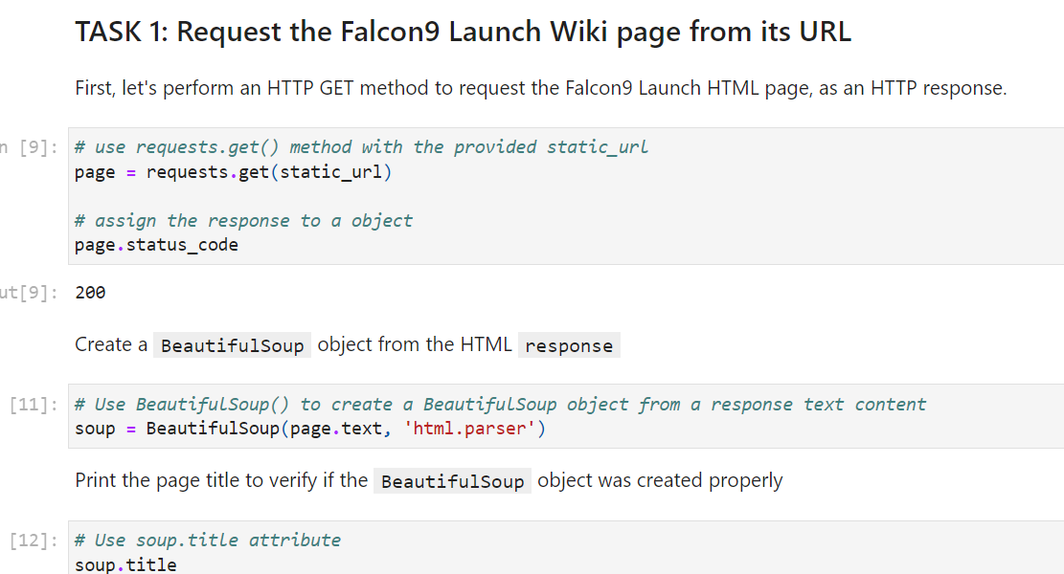
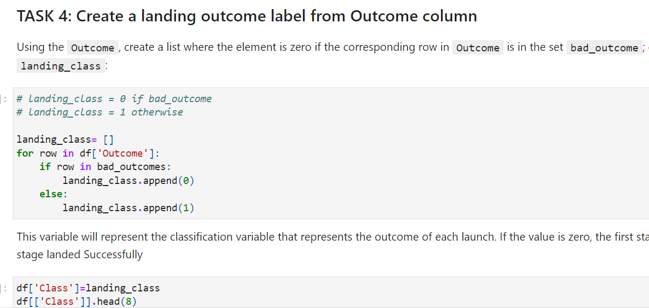
Data Collection & Cleaning
Place your flowchart of web scraping here
Data scraping figure with python coding:
Data Wrangling figure with python coding

Slide 9
EDA with Data Visualization
Data visualization gives insights on the hidden raw data information. Visualization were applied to identify key variables affecting the efficiency of launching.
The following are a list of possible factors that can affect launching success rate:
Payload mass
orbit type
location and proximities of a launch site, i.e., the initial position of rockets trajectories.
GitHub URL of EDA with data visualization notebook: https://github.com/jbandzo/IBM-DATA-SCIENCE/blob/main/Interactive%20Visual%20Analytics%20with%20Folium%20lab.ipynb

Slide 10
EDA with SQL
Using bullet point format, summarize the SQL queries you performed:
%sql select Unique(LAUNCH_SITE) from SPACEXTBL
%SQL select LAUNCH_SITE from SPACEXTBL where (LAUCH_SITE LIKE ‘CCA%’ LIMIT 5;
%sql select avg (PAYLOAD_MASS_KG) as payloadmass from SPACEXTBL;
%sql select min(DATE) from SPACEXTBL;
Sql select distinct BOOSTER_VERSION from SACEXTBL where PAYLOAD_MASS_KG between 4000 and 6000 and LANDING_OUTCOME=‘success (drone ship)’;
%sql select count (MISSION_OUTCOME) as missionoutcomes from SPACEX GROUP by MISSION_OUTCOME;
%sql select BOOSTER_VERSION as boosterversion from SAPCEXTBL where PAYLOAD_MASS_KG_= (select max(PAYLOAD_MASS_KG_)
%sql select BOOSTER_VERSION as boosterversion from SPACECTBL where LANDING_OUTCOME=‘Failure(drone ship)’ and date like ‘2015%’
%sql seect LANDING_OUTCOME FROM SPACEXTBL where date between ‘200-06-04’ and ‘2017-03-20’ order by date desc;

Slide 11
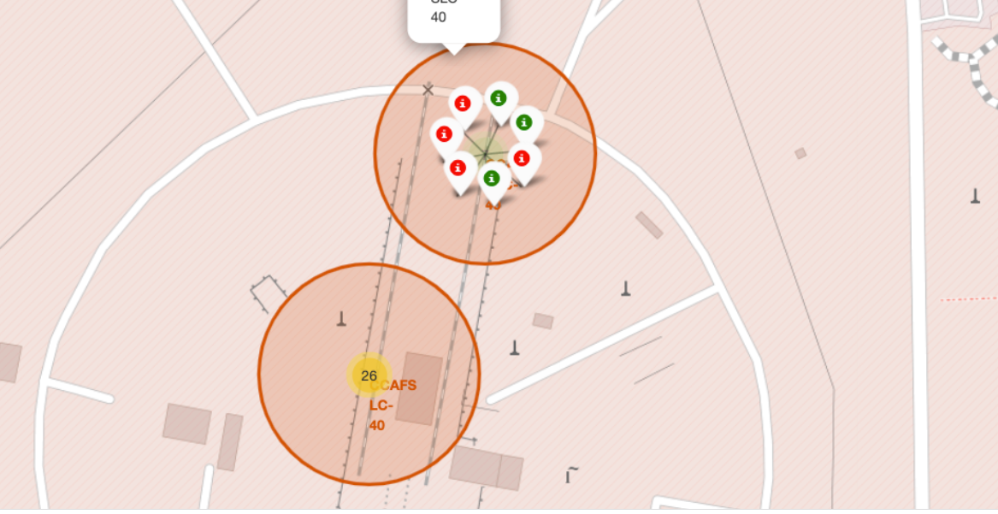
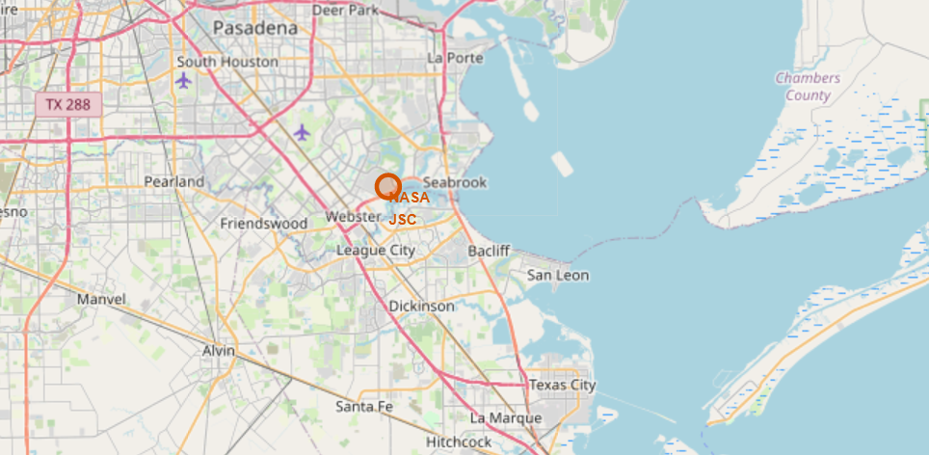
Build an Interactive Map with Folium
The objective summarize of the map objects such as markers, circles, lines, etc. created and added to a folium map:
Markers are the items used for marking a location on a map.
A Circles is used as a function to circle the coordinates.
Lines are drown to show the distance between the launching sites
The GitHub URL of interactive map with Folium maps: https://github.com/jbandzo/IBM-DATA-SCIENCE/blob/main/Interactive%20Visual%20Analytics%20with%20Folium%20lab.ipynb
The figures below are examples of folium virtualizations which shows the sites coordinates and geographic location:

Slide 12
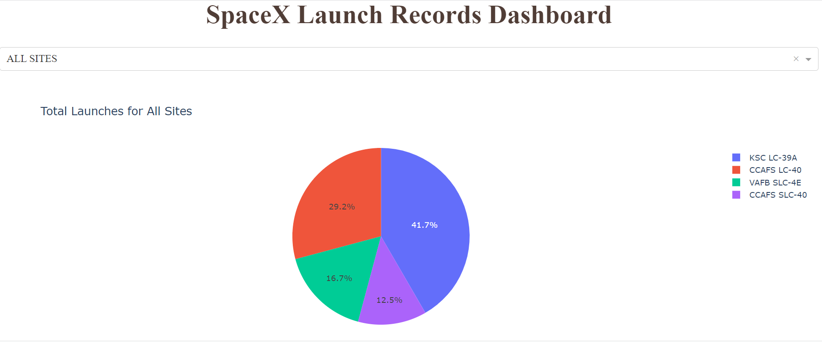
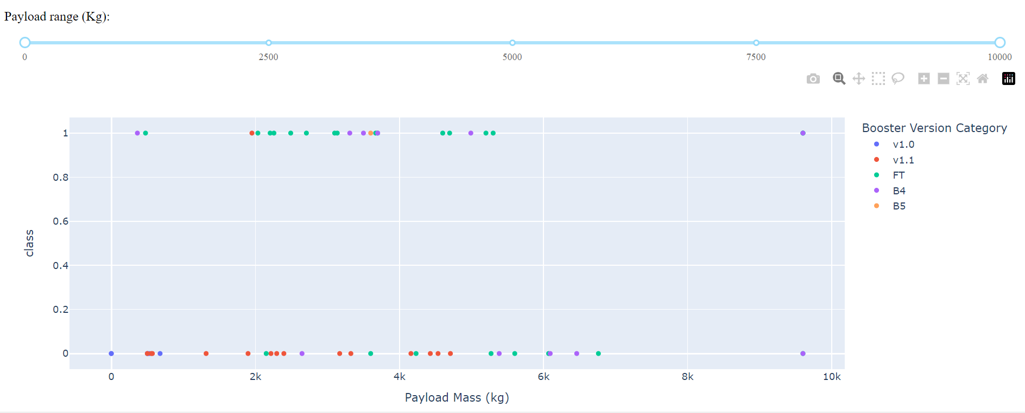
Build a Dashboard with Plotly Dash
The pie chart visualize the results of the Total Launches for all sites. It can be depicted CCAPS LC-40 was the highest.
Scatter plot was used to classify the launches.
The plots were created to discover some of the factors that affect launching success rate.
GitHub URL of Plotly Dash lab:

Slide 13
Predictive Analysis (Classification)
Data analysis visualizations were developed to predict if the Falcon 9 first stage will land successfully. SpaceX advertises Falcon 9 rocket launches on its website with a cost of 62 million dollars; other providers cost upward of 165 million dollars each, much of the savings is due to the fact that SpaceX can reuse the first stage.
Exploratory Data Analysis and Feature Engineering were performed and findings reveled that Falcon 9 first stage will land successfully.
Data analytics techniques like classification were employed to develop a model that depicts insights about variation between Falcon 9 and SpaceX, including key factors affecting the rate of launching.
The model was developed and tested for accuracy using various algorithms.
GitHub URL of analysis lab: https://github.com/jbandzo/IBM-DATA-SCIENCE/blob/main/Exploratory%20Data%20Analysis%20for%20Data%20Visualization.ipynb

Slide 14
Results
The study discovered some of the factors by analyzing the existing launch site locations
Exploratory data analysis results
Interactive analytics demo in screenshots
Predictive analysis results

Slide 15

Section 2

Slide 16
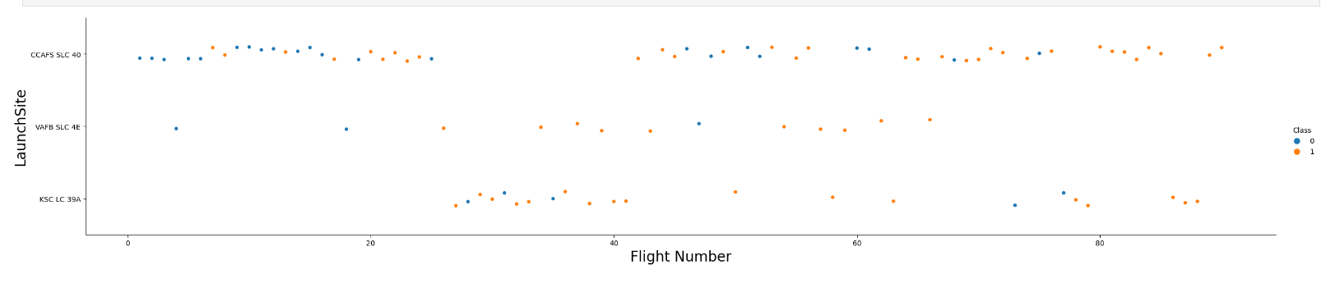
Flight Number vs. Launch Site
The Fig depicts classification between Falcon9 and Space X by Flight Number and Launch Site.

Slide 17
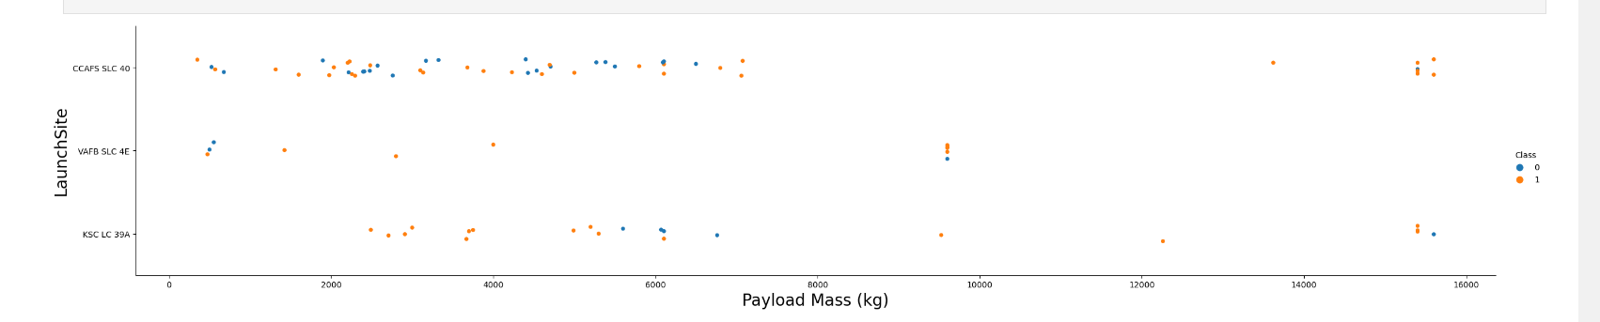
Payload vs. Launch Site
The Fig depicts classification between Falcon9 and Space X by Payload Mass and Launch Site.

Slide 18
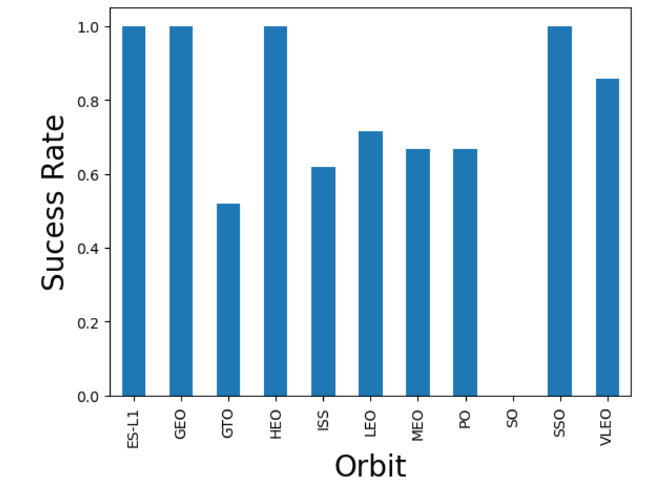
Success Rate vs. Orbit Type
The Fig depicts the relation between Success rate and Orbit.

Slide 19
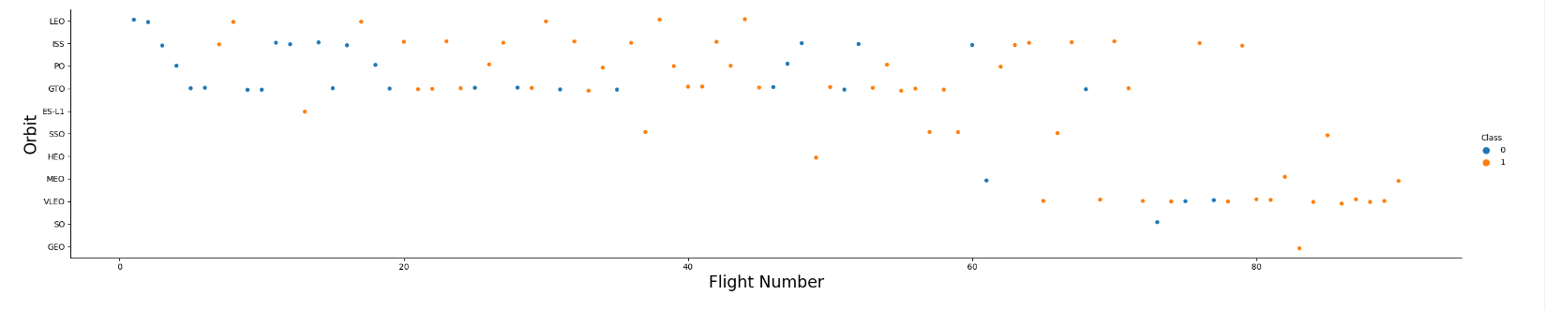
Flight Number vs. Orbit Type
The Fig depicts classification between Falcon9 and Space X by Flight Number and Orbit.

Slide 20
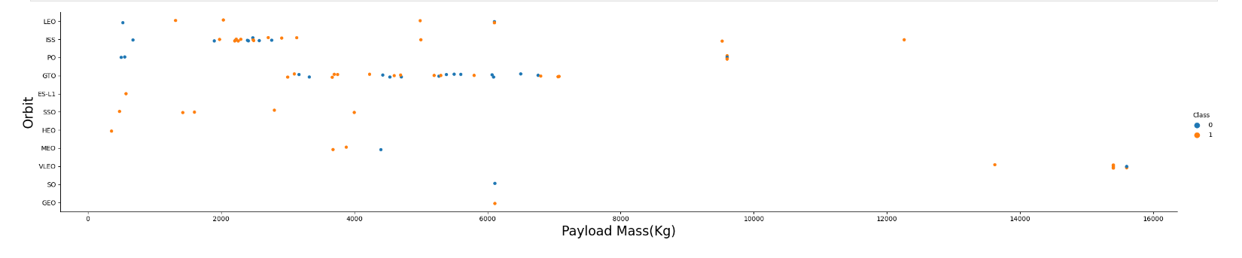
Payload vs. Orbit Type
The Fig depicts classification between Falcon9 and Space X by Orbit and Payload.

Slide 21
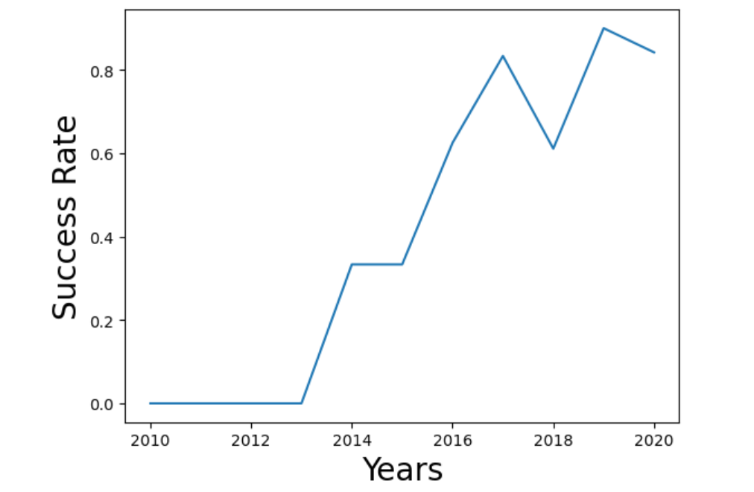
Launch Success Yearly Trend
The Fig depicts the relation between Success rate and Years.

Slide 22
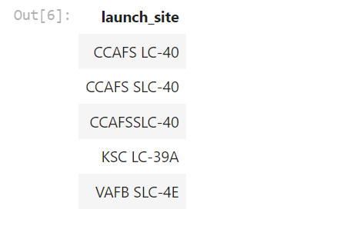
All Launch Site Names
The names of the unique launch sites

Slide 23
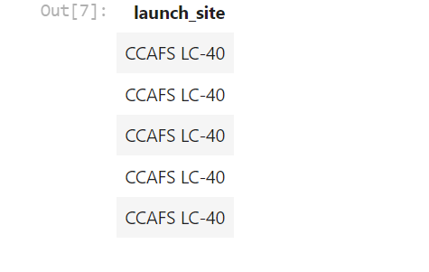
Launch Site Names Begin with 'CCA'
5 records of where launch sites begin with `CCA`

Slide 24
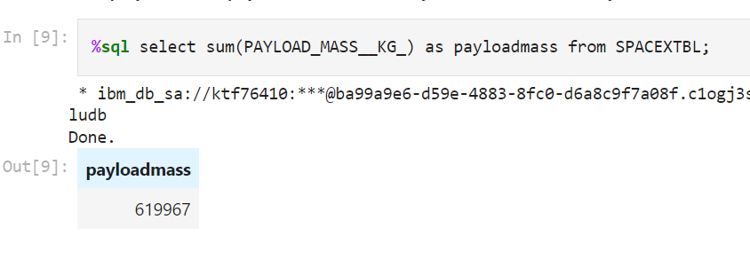
Total Payload Mass
Calculate the total payload carried by boosters from NASA

Slide 25
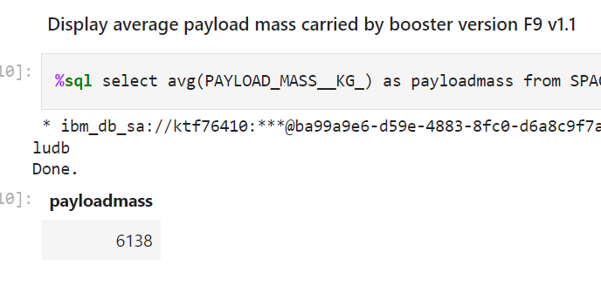
Average Payload Mass by F9 v1.1
Calculation of the average payload mass carried by booster version F9 v1.1

Slide 26
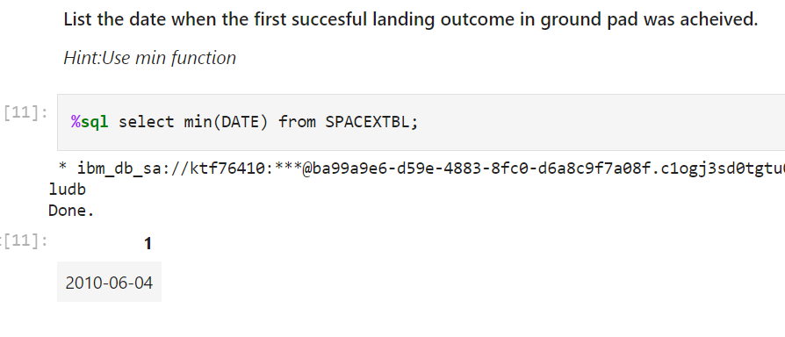
First Successful Ground Landing Date

Slide 27
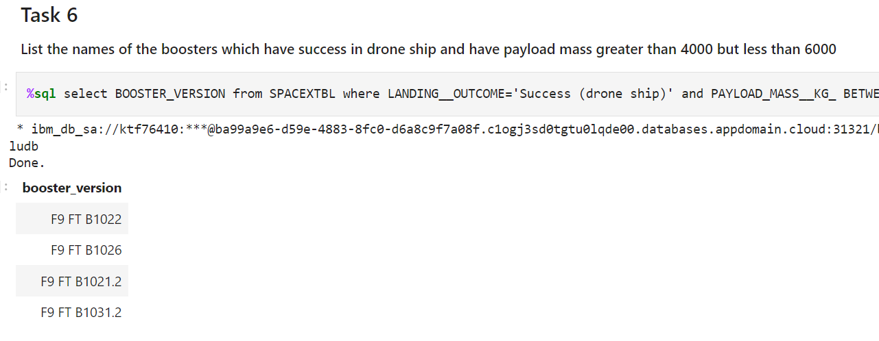
Successful Drone Ship Landing with Payload between 4000 and 6000
List the names of boosters which have successfully landed on drone ship and had payload mass greater than 4000 but less than 6000

Slide 28
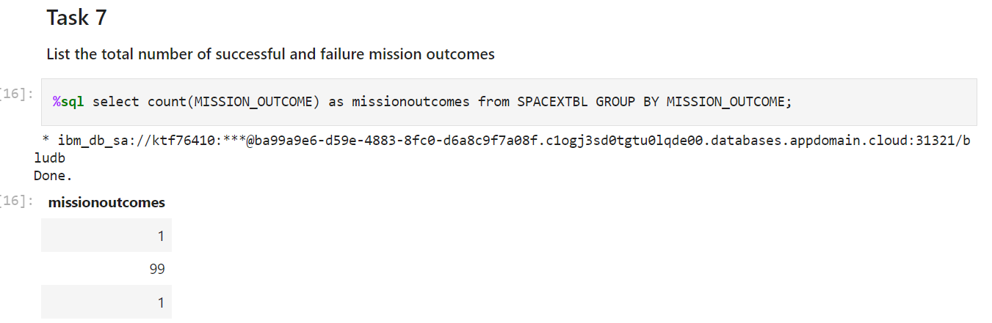
Total Number of Successful and Failure Mission Outcomes
Calculate of the total number of successful and failure mission outcomes

Slide 29
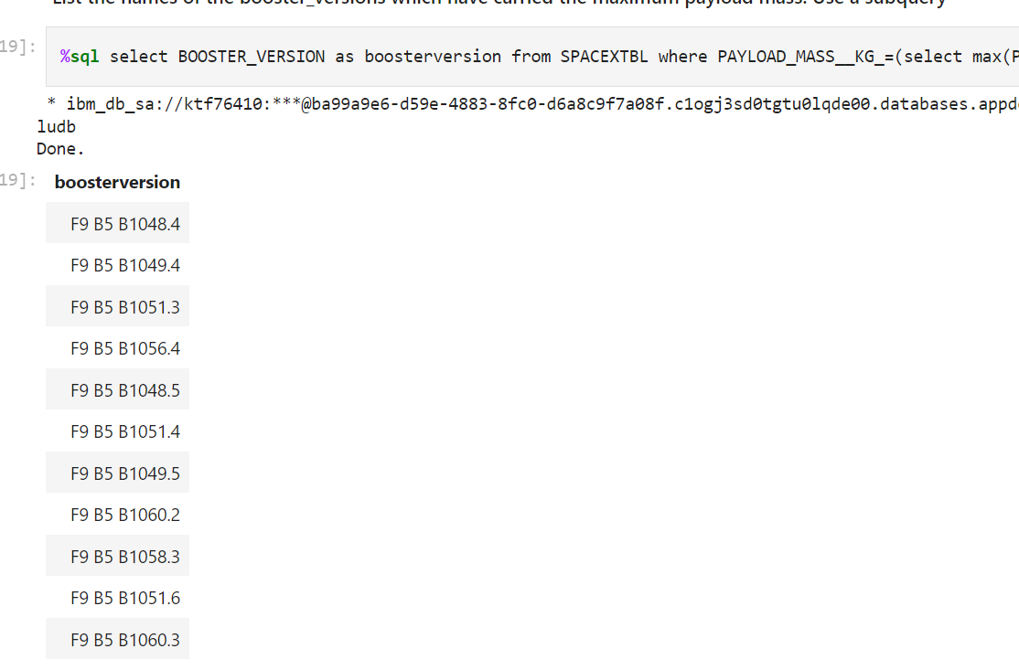
Boosters Carried Maximum Payload
List of the names of the booster which have carried the maximum payload mass

Slide 30
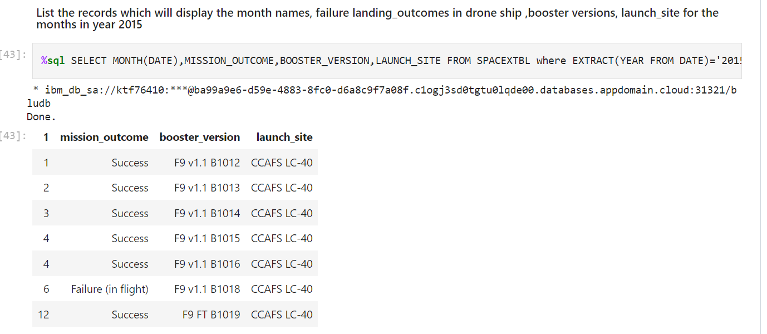
2015 Launch Records
List of the failed landing outcomes in drone ship, their booster versions, and launch site names for in year 2015

Slide 31
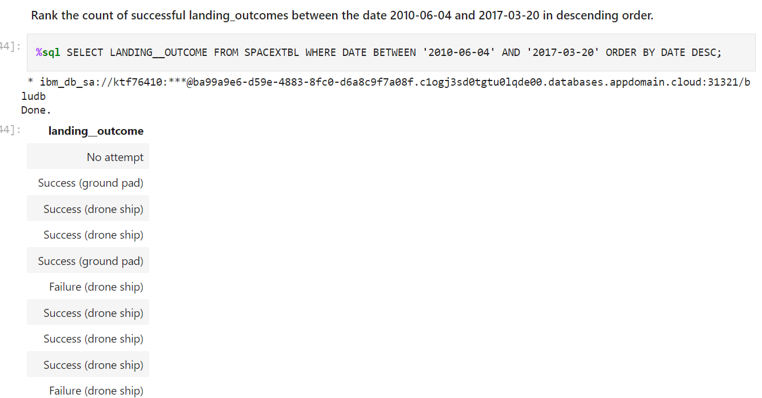
Rank Landing Outcomes Between 2010-06-04 and 2017-03-20
Rank the count of landing outcomes (such as Failure (drone ship) or Success (ground pad)) between the date 2010-06-04 and 2017-03-20, in descending order

Slide 32

Section 3

Slide 33
Folium Map Screenshot 1

Slide 34
Folium Map Screenshot 2

Slide 35

Section 4

Slide 36
Total launch for all sites
The pie chart visualize the results of the Total Launches for all sites. It can be depicted CCAPS LC-40 was the highest.

Slide 37
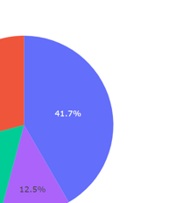
Pie chat Fig. of the highest launch
Pie chart Fig. for the launch site with highest launch success ratio

Slide 38
Booster Version Category by Class vs Payload Mass
Payload vs. Launch Outcome scatter plot for all sites, with different payload selected in the range slider

Slide 39

Section 5

Slide 40
Classification Accuracy
Visualize the built model accuracy for all built classification models, in a bar chart
Find which model has the highest classification accuracy

Slide 41
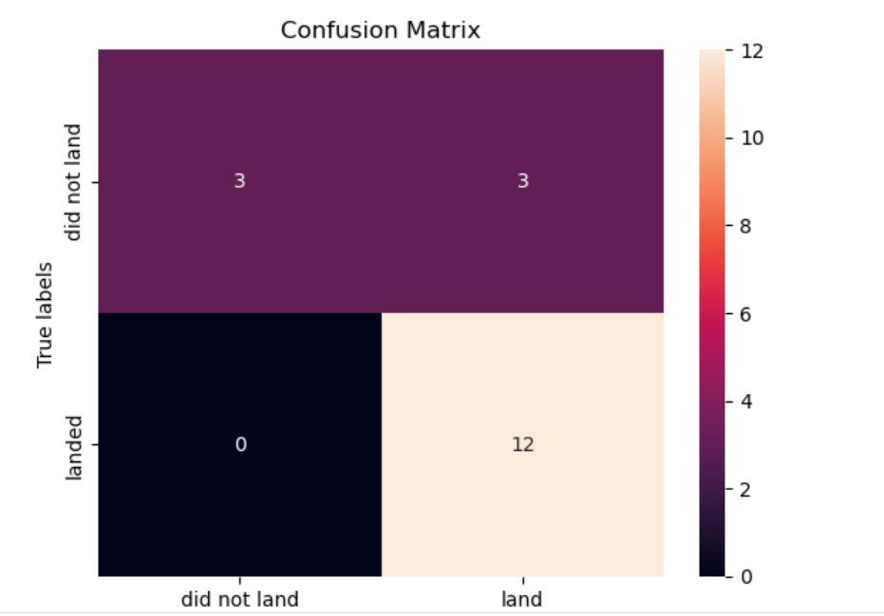
Confusion Matrix

Slide 42
Conclusions
Conclusion 1- From the results finding, we can conclude that location and proximities of a launch site, i.e., the initial position of rockets trajectories have a significant factor on launching rate.
Conclusion 2 - Payload mass also depicted as significant factor

Slide 43
Appendix
Include any relevant assets like Python code snippets, SQL queries, charts, Notebook outputs, or data sets that you may have created during this project
https://en.wikipedia.org/wiki/List_of_Falcon_9_and_Falcon_Heavy_launches

Slide 44


